Slide 1
Introduction to Differential Equations – Lecture 15
Fei Qi
fei.qi@du.edu
https://feiqimath.github.io

Slide 2
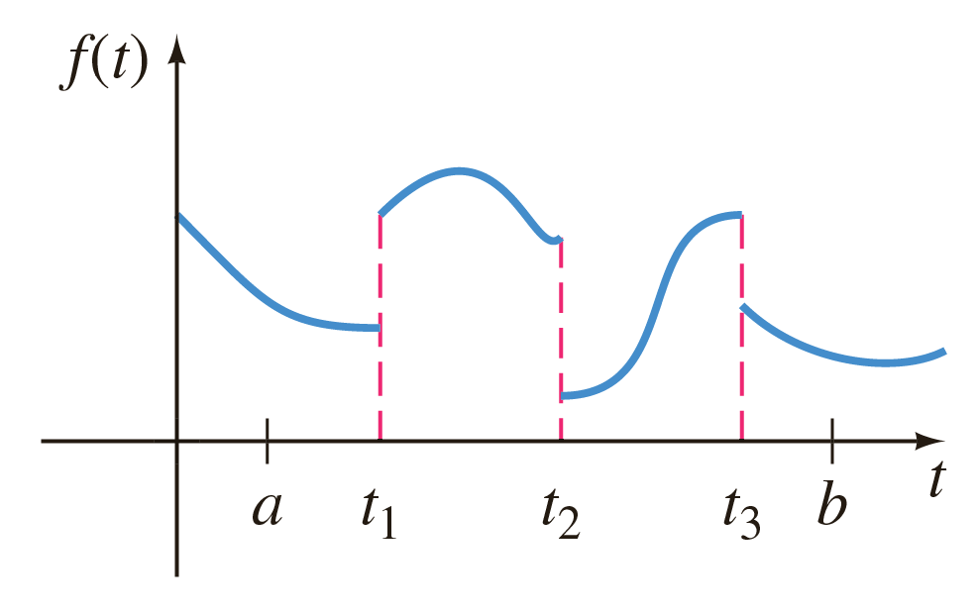
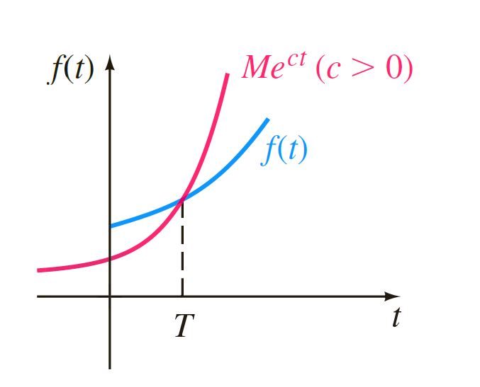
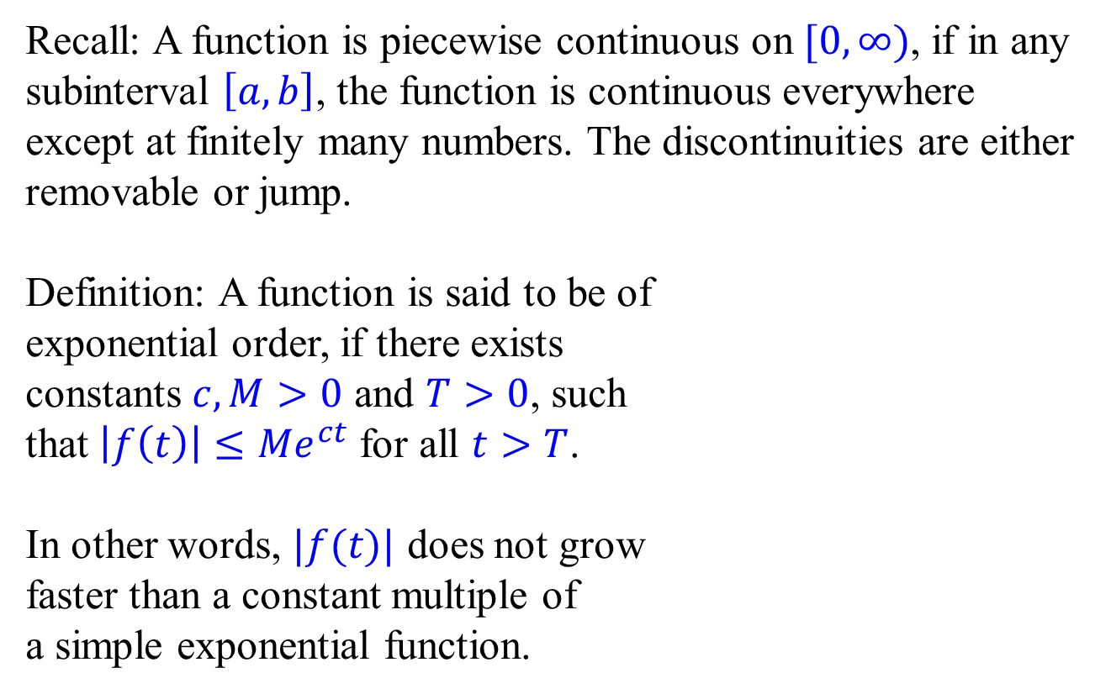
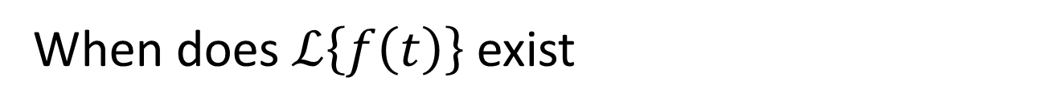
When does $ℒ\left\{f\left(t\right)\right\}$ exist
Recall: A function is piecewise continuous on $[0, ∞)$, if in any subinterval $\left[a,b\right]$, the function is continuous everywhere except at finitely many numbers. The discontinuities are either removable or jump.
Definition: A function is said to be of exponential order, if there exists constants $c,M>0$ and $T>0$, such that $\left|f\left(t\right)\right|≤Me^{ct}$ for all $t>T$.
In other words, $|f(t)|$ does not grow faster than a constant multiple of a simple exponential function.

Slide 3
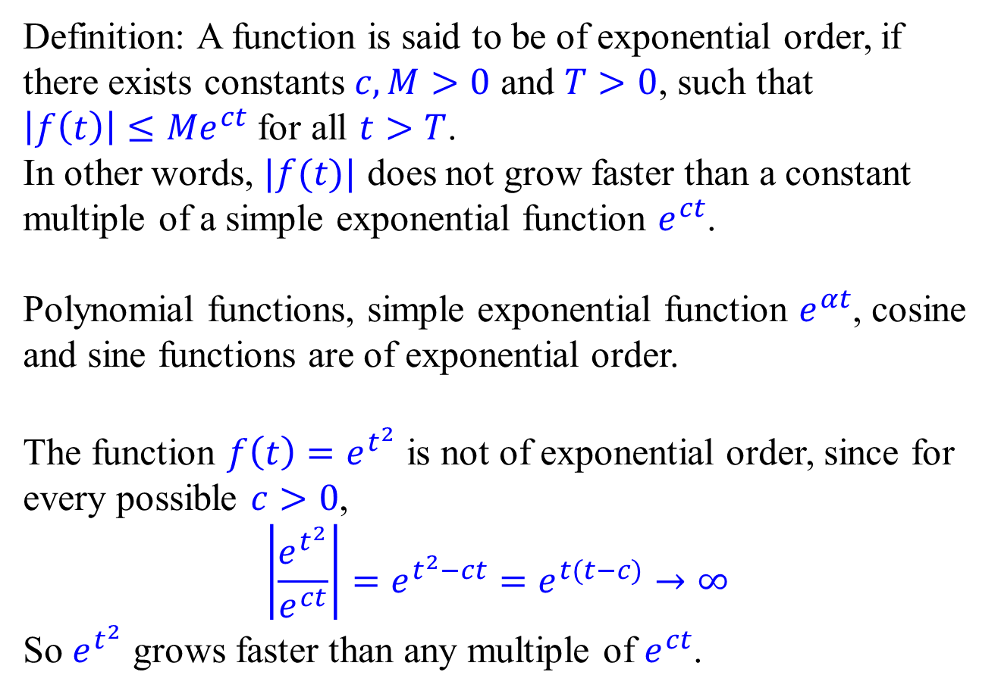
When does $ℒ\left\{f\left(t\right)\right\}$ exist
Definition: A function is said to be of exponential order, if there exists constants $c,M>0$ and $T>0$, such that $\left|f\left(t\right)\right|≤Me^{ct}$ for all $t>T$.
In other words, $|f(t)|$ does not grow faster than a constant multiple of a simple exponential function $e^{ct}$.
Polynomial functions, simple exponential function $e^{αt}$, cosine and sine functions are of exponential order.
The function ${f\left(t\right)=e}^{t^{2}}$ is not of exponential order, since for every possible $c>0$, $$\left|\frac{e^{t^{2}}}{e^{ct}}\right|=e^{t^{2}−ct}=e^{t(t−c)}→∞$$
So $e^{t^{2}}$ grows faster than any multiple of $e^{ct}$.

Slide 4
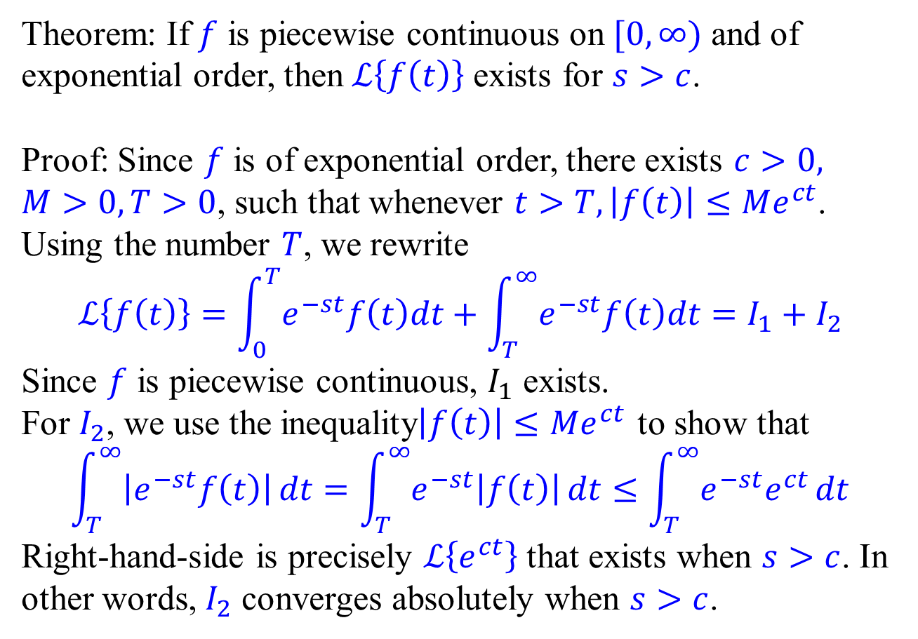
When does $ℒ\left\{f\left(t\right)\right\}$ exist
Theorem: If $f$ is piecewise continuous on $[0, ∞)$ and of exponential order, then $ℒ\left\{f\left(t\right)\right\}$ exists for $s>c$.
Proof: Since $f$ is of exponential order, there exists $c>0,$ $M>0,T>0$, such that whenever $t>T, \left|f\left(t\right)\right|≤Me^{ct}$. Using the number $T$, we rewrite
$$ℒ\left\{f\left(t\right)\right\}=\int_{0}^{T}{e^{−st}f\left(t\right)dt}+\int_{T}^{∞}{e^{−st}f\left(t\right)dt}=I_{1}+I_{2}$$
Since $f$ is piecewise continuous, $I_{1}$ exists.
For $I_{2}$, we use the inequality$\left|f\left(t\right)\right|≤Me^{ct}$ to show that
$$\int_{T}^{∞}{\left|e^{−st}f\left(t\right)\right|}dt=\int_{T}^{∞}{e^{−st}\left|f\left(t\right)\right|}dt≤\int_{T}^{∞}{e^{−st}e^{ct}}dt$$
Right-hand-side is precisely $ℒ\left\{e^{ct}\right\}$ that exists when $s>c$. In other words, $I_{2}$ converges absolutely when $s>c$.

Slide 5
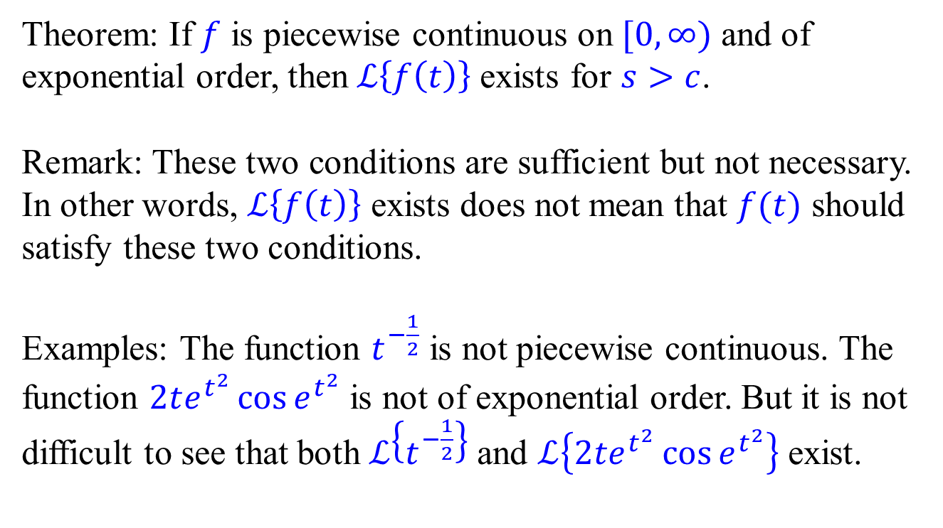
When does $ℒ\left\{f\left(t\right)\right\}$ exist
Theorem: If $f$ is piecewise continuous on $[0, ∞)$ and of exponential order, then $ℒ\left\{f\left(t\right)\right\}$ exists for $s>c$.
Remark: These two conditions are sufficient but not necessary. In other words, $ℒ\left\{f\left(t\right)\right\}$ exists does not mean that $f(t)$ should satisfy these two conditions.
Examples: The function $t^{−\frac{1}{2}}$ is not piecewise continuous. The function $2te^{t^{2}}\cos{e^{t^{2}}}$ is not of exponential order. But it is not difficult to see that both $ℒ\left\{t^{−\frac{1}{2}}\right\}$ and $ℒ\left\{2te^{t^{2}}\cos{e^{t^{2}}}\right\}$ exist.

Slide 6
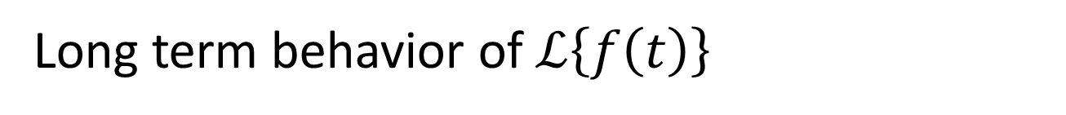
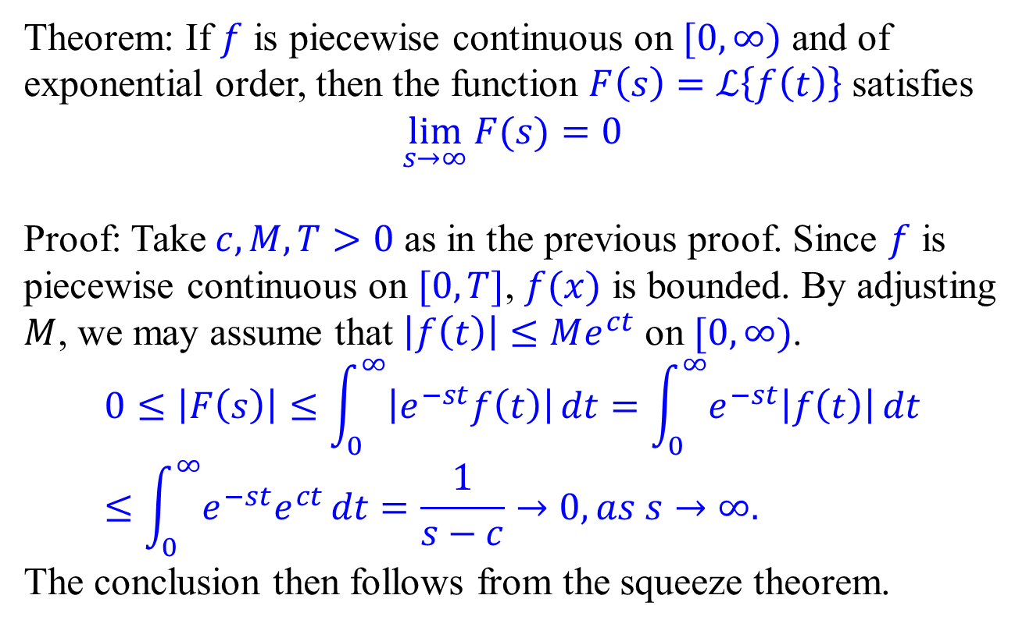
Long term behavior of $ℒ\left\{f\left(t\right)\right\}$
Theorem: If $f$ is piecewise continuous on $[0, ∞)$ and of exponential order, then the function $F\left(s\right)=ℒ\left\{f\left(t\right)\right\}$ satisfies
$$\lim_{s→∞}{F(s)}=0$$
Proof: Take $c,M,T>0$ as in the previous proof. Since $f$ is piecewise continuous on $[0,T]$, $f(x)$ is bounded. By adjusting $M$, we may assume that $\left|f\left(t\right)\right|≤Me^{ct}$ on $[0, ∞)$.
$$0≤\left|F\left(s\right)\right|≤\int_{0}^{∞}{\left|e^{−st}f\left(t\right)\right|}dt=\int_{0}^{∞}{e^{−st}\left|f\left(t\right)\right|}dt≤\int_{0}^{∞}{e^{−st}e^{ct}}dt=\frac{1}{s−c}→0, as s→∞.$$
The conclusion then follows from the squeeze theorem.

Slide 7
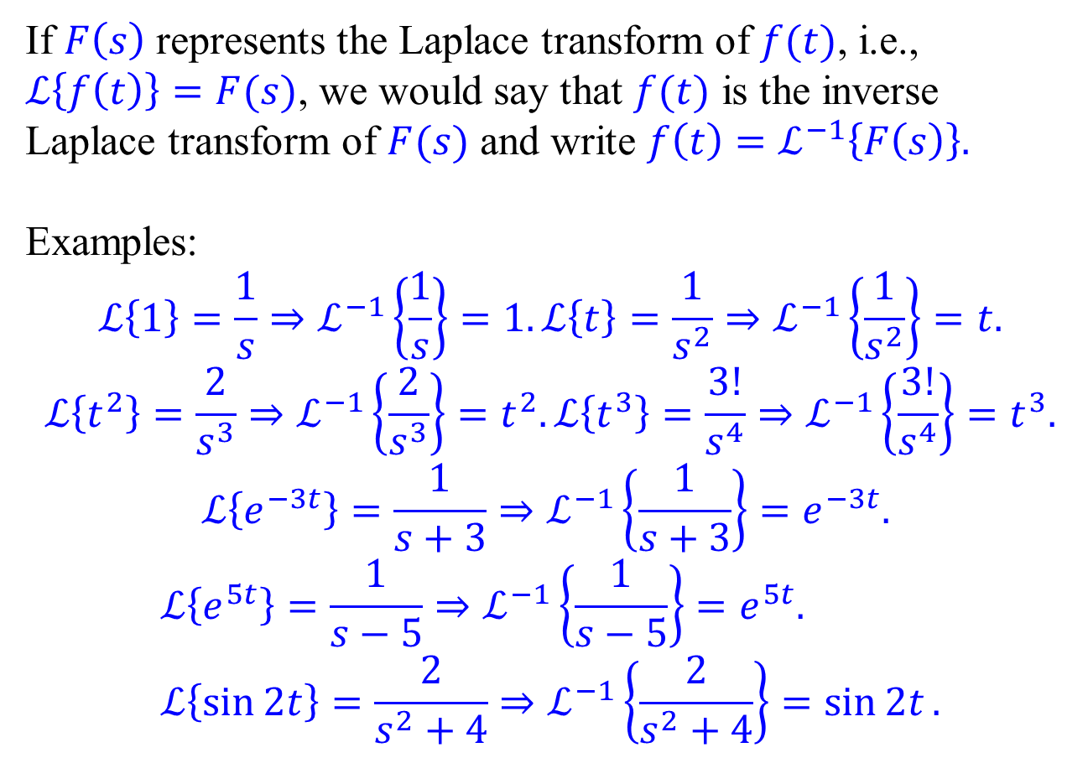
Inverse Laplace transform
If $F\left(s\right)$ represents the Laplace transform of $f(t)$, i.e., $ℒ\left\{f\left(t\right)\right\}=F(s)$, we would say that $f(t)$ is the inverse Laplace transform of $F(s)$ and write $f\left(t\right)=ℒ^{−1}\left\{F\left(s\right)\right\}.$
Examples:
$$ℒ\left\{1\right\}=\frac{1}{s}⇒ℒ^{−1}\left\{\frac{1}{s}\right\}=1. ℒ\left\{t\right\}=\frac{1}{s^{2}}⇒ℒ^{−1}\left\{\frac{1}{s^{2}}\right\}=t.$$
$$ℒ\left\{t^{2}\right\}=\frac{2}{s^{3}}⇒ℒ^{−1}\left\{\frac{2}{s^{3}}\right\}=t^{2}.ℒ\left\{t^{3}\right\}=\frac{3!}{s^{4}}⇒ℒ^{−1}\left\{\frac{3!}{s^{4}}\right\}=t^{3}.$$
$$ℒ\left\{e^{−3t}\right\}=\frac{1}{s+3}⇒ℒ^{−1}\left\{\frac{1}{s+3}\right\}=e^{−3t}.$$
$$ℒ\left\{e^{5t}\right\}=\frac{1}{s−5}⇒ℒ^{−1}\left\{\frac{1}{s−5}\right\}=e^{5t}. \\ ℒ\left\{\sin{2t}\right\}=\frac{2}{s^{2}+4}⇒ℒ^{−1}\left\{\frac{2}{s^{2}+4}\right\}=\sin{2t}.$$

Slide 8
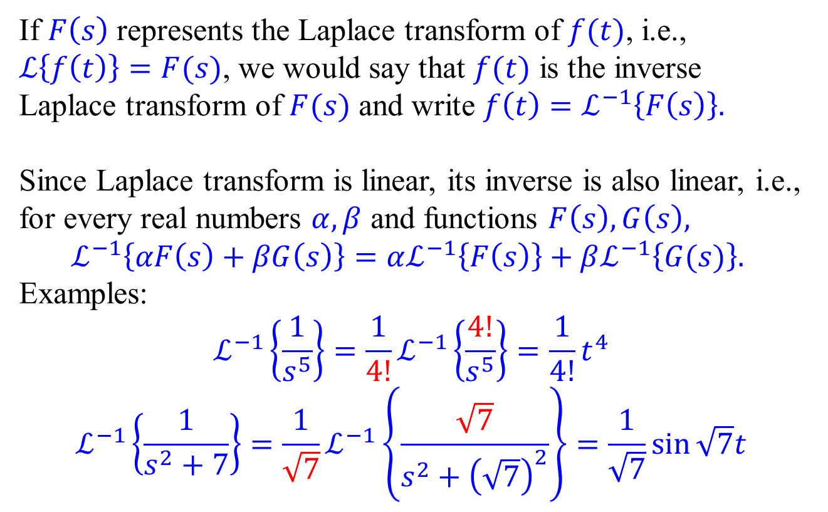
Linearity of inverse Laplace transform
If $F\left(s\right)$ represents the Laplace transform of $f(t)$, i.e., $ℒ\left\{f\left(t\right)\right\}=F(s)$, we would say that $f(t)$ is the inverse Laplace transform of $F(s)$ and write $f\left(t\right)=ℒ^{−1}\left\{F\left(s\right)\right\}.$
Since Laplace transform is linear, its inverse is also linear, i.e., for every real numbers $α, β$ and functions $F\left(s\right), G\left(s\right),$
$$ℒ^{−1}\left\{αF\left(s\right)+βG\left(s\right)\right\}=αℒ^{−1}\left\{F\left(s\right)\right\}+βℒ^{−1}\left\{G(s)\right\}.$$
Examples:
$$ℒ^{−1}\left\{\frac{1}{s^{5}}\right\}=\frac{1}{4!}ℒ^{−1}\left\{\frac{4!}{s^{5}}\right\}=\frac{1}{4!}t^{4}$$
$$ℒ^{−1}\left\{\frac{1}{s^{2}+7}\right\}=\frac{1}{\sqrt{7}}ℒ^{−1}\left\{\frac{\sqrt{7}}{s^{2}+{\left(\sqrt{7}\right)}^{2}}\right\}=\frac{1}{\sqrt{7}}\sin{\sqrt{7}t}$$

Slide 9
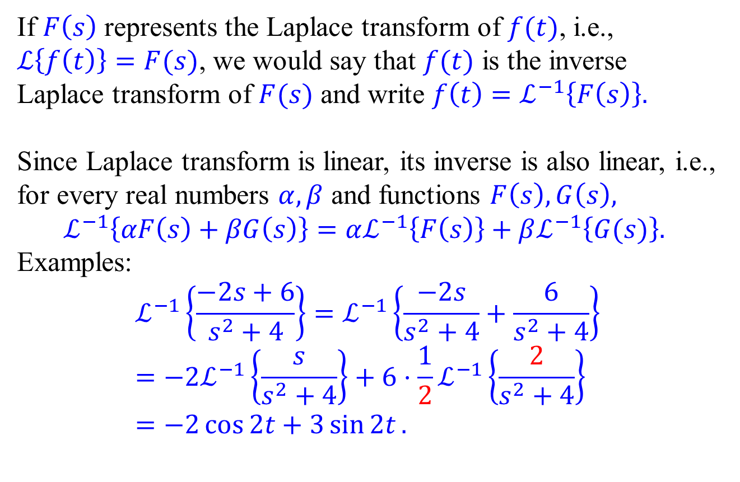
Linearity of inverse Laplace transform
If $F\left(s\right)$ represents the Laplace transform of $f(t)$, i.e., $ℒ\left\{f\left(t\right)\right\}=F(s)$, we would say that $f(t)$ is the inverse Laplace transform of $F(s)$ and write $f\left(t\right)=ℒ^{−1}\left\{F\left(s\right)\right\}.$
Since Laplace transform is linear, its inverse is also linear, i.e., for every real numbers $α, β$ and functions $F\left(s\right), G\left(s\right),$
$$ℒ^{−1}\left\{αF\left(s\right)+βG\left(s\right)\right\}=αℒ^{−1}\left\{F\left(s\right)\right\}+βℒ^{−1}\left\{G(s)\right\}.$$
Examples:
$$ℒ^{−1}\left\{\frac{−2s+6}{s^{2}+4}\right\}=ℒ^{−1}\left\{\frac{−2s}{s^{2}+4}+\frac{6}{s^{2}+4}\right\}=−2ℒ^{−1}\left\{\frac{s}{s^{2}+4}\right\}+6⋅\frac{1}{2}ℒ^{−1}\left\{\frac{2}{s^{2}+4}\right\} \\ =−2\cos{2t}+3\sin{2t}.$$

Slide 10
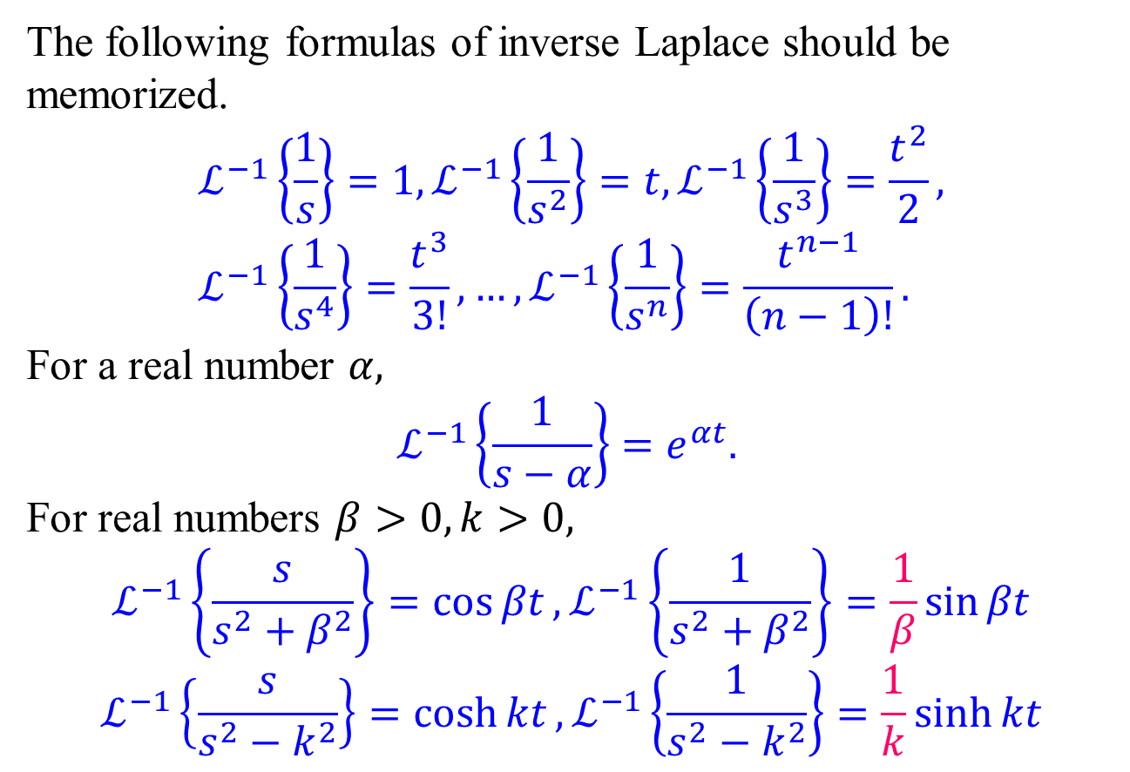
Important formulas of inverse Laplace
The following formulas of inverse Laplace should be memorized.
$$ℒ^{−1}\left\{\frac{1}{s}\right\}=1, ℒ^{−1}\left\{\frac{1}{s^{2}}\right\}=t, ℒ^{−1}\left\{\frac{1}{s^{3}}\right\}=\frac{t^{2}}{2}, \\ ℒ^{−1}\left\{\frac{1}{s^{4}}\right\}=\frac{t^{3}}{3!},…,ℒ^{−1}\left\{\frac{1}{s^{n}}\right\}=\frac{t^{n−1}}{\left(n−1\right)!}.$$
For a real number $α,$
$$ℒ^{−1}\left\{\frac{1}{s−α}\right\}=e^{αt}.$$
For real numbers $β>0,k>0,$
$$ℒ^{−1}\left\{\frac{s}{s^{2}+β^{2}}\right\}=\cos{βt}, ℒ^{−1}\left\{\frac{1}{s^{2}+β^{2}}\right\}=\frac{1}{β}\sin{βt}$$
$$ℒ^{−1}\left\{\frac{s}{s^{2}−k^{2}}\right\}=\cosh{kt}, ℒ^{−1}\left\{\frac{1}{s^{2}−k^{2}}\right\}=\frac{1}{k}\sinh{kt}$$

Slide 11
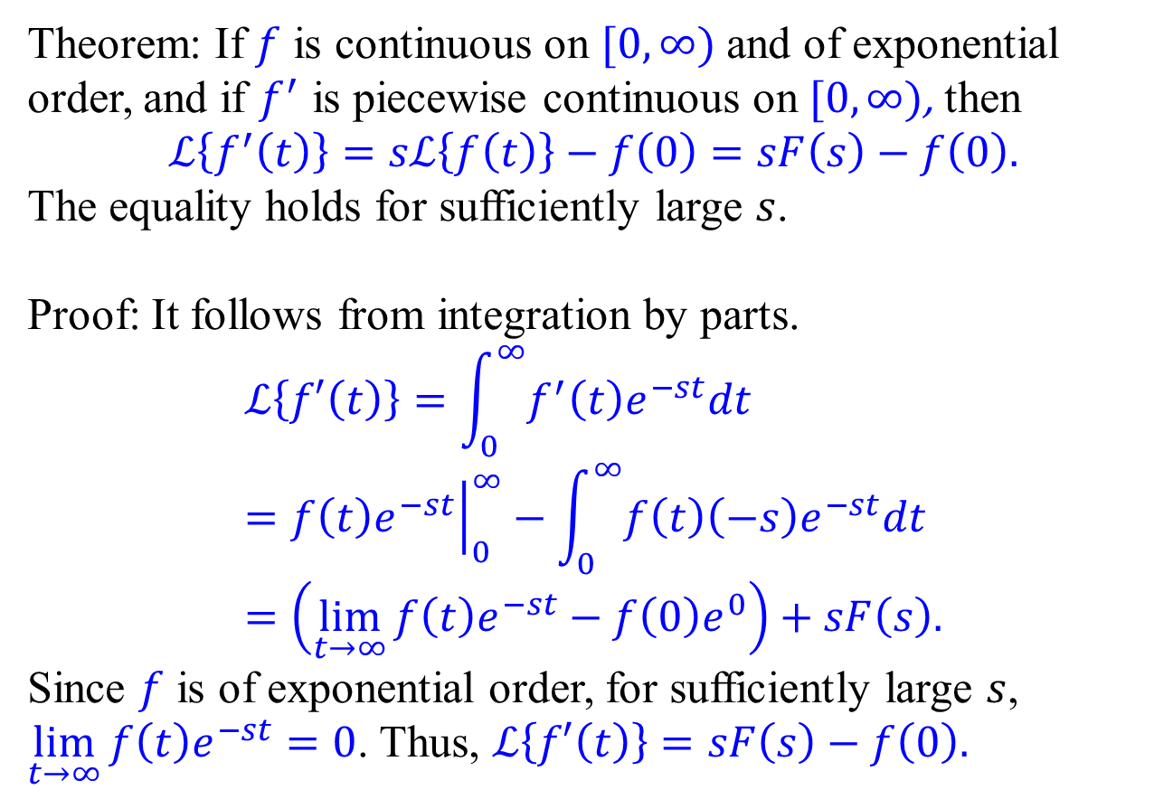
Laplace Transform of derivatives
Theorem: If $f$ is continuous on $[0, ∞)$ and of exponential order, and if $f^{′}$ is piecewise continuous on $[0, ∞)$, then
$$ℒ\left\{f^{′}\left(t\right)\right\}=sℒ\left\{f\left(t\right)\right\}−f\left(0\right)=sF\left(s\right)−f\left(0\right).$$
The equality holds for sufficiently large $s$.
Proof: It follows from integration by parts.
$$ℒ\left\{f′\left(t\right)\right\}=\int_{0}^{∞}{f^{′}\left(t\right)e^{−st}dt}={\left.f\left(t\right)e^{−st}\right|}_{0}^{∞}−\int_{0}^{∞}{f\left(t\right)\left(−s\right)e^{−st}dt} \\ =\left(\lim_{t→∞}{f\left(t\right)e^{−st}}−f\left(0\right)e^{0}\right)+sF\left(s\right).$$
Since $f$ is of exponential order, for sufficiently large $s$, $\lim_{t→∞}{f\left(t\right)e^{−st}}=0$. Thus, $ℒ\left\{f′\left(t\right)\right\}=sF\left(s\right)−f\left(0\right).$

Slide 12
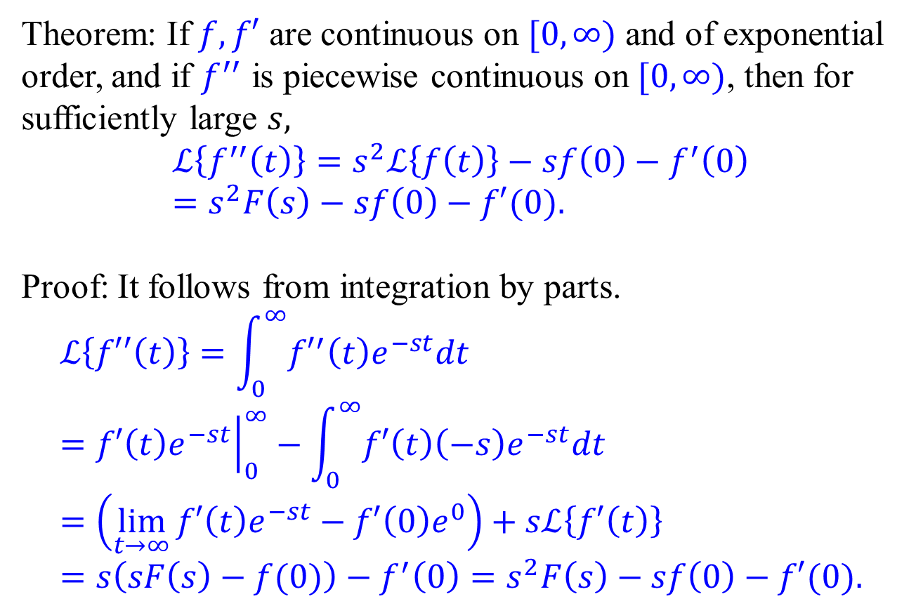
Laplace Transform of derivatives
Theorem: If $f, f′$ are continuous on $[0, ∞)$ and of exponential order, and if $f^{′′}$ is piecewise continuous on $[0, ∞)$, then for sufficiently large $s,$
$$ℒ\left\{f^{′′}\left(t\right)\right\}=s^{2}ℒ\left\{f\left(t\right)\right\}−sf\left(0\right)−f^{′}\left(0\right)=s^{2}F\left(s\right)−sf\left(0\right)−f′(0).$$
Proof: It follows from integration by parts.
$$ℒ\left\{f′′\left(t\right)\right\}=\int_{0}^{∞}{{f′}^{′}\left(t\right)e^{−st}dt}={\left.f′\left(t\right)e^{−st}\right|}_{0}^{∞}−\int_{0}^{∞}{f′\left(t\right)\left(−s\right)e^{−st}dt} \\ =\left(\lim_{t→∞}{f′\left(t\right)e^{−st}}−f′\left(0\right)e^{0}\right)+sℒ\left\{f′\left(t\right)\right\} \\ =s\left(sF\left(s\right)−f(0)\right)−f^{′}\left(0\right)=s^{2}F\left(s\right)−sf\left(0\right)−f′(0).$$

Slide 13
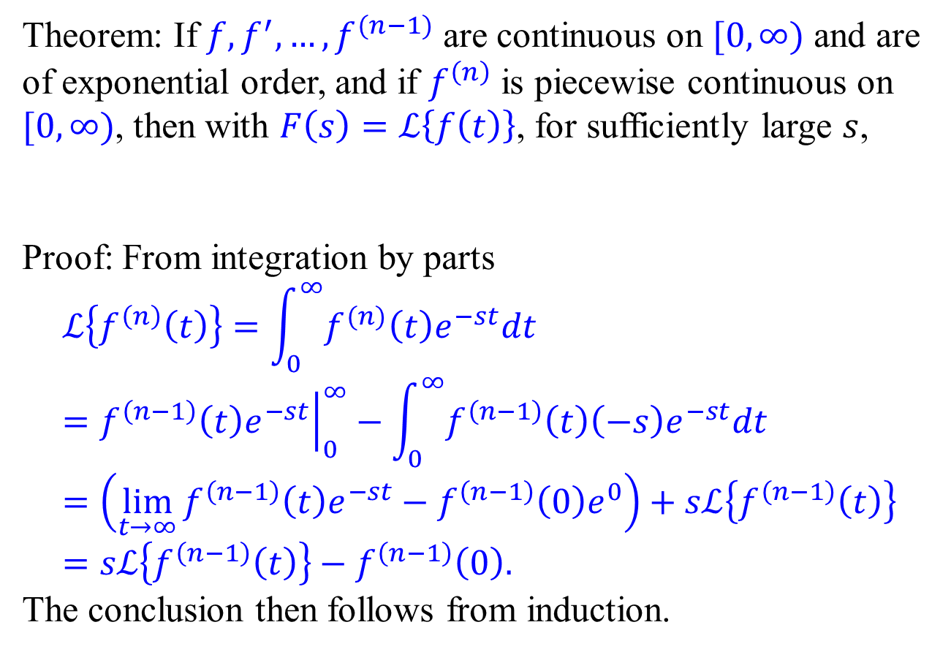
Laplace Transform of derivatives
Theorem: If $f,f^{′},…, f^{(n−1)}$ are continuous on $[0, ∞)$ and are of exponential order, and if $f^{\left(n\right)}$ is piecewise continuous on $[0, ∞)$, then with $F\left(s\right)=ℒ\left\{f\left(t\right)\right\}$, for sufficiently large $s$,
Proof: From integration by parts $$ℒ\left\{f^{\left(n\right)}\left(t\right)\right\}=\int_{0}^{∞}{f^{(n)}\left(t\right)e^{−st}dt}={\left.f^{\left(n−1\right)}\left(t\right)e^{−st}\right|}_{0}^{∞}−\int_{0}^{∞}{f^{\left(n−1\right)}\left(t\right)\left(−s\right)e^{−st}dt} \\ =\left(\lim_{t→∞}{f^{\left(n−1\right)}\left(t\right)e^{−st}}−f^{\left(n−1\right)}\left(0\right)e^{0}\right)+sℒ\left\{f^{\left(n−1\right)}\left(t\right)\right\} \\ =sℒ\left\{f^{\left(n−1\right)}\left(t\right)\right\}−f^{\left(n−1\right)}\left(0\right).$$
The conclusion then follows from induction.
$$ℒ\left\{f^{\left(n\right)}\left(t\right)\right\}=s^{n}F\left(s\right)−s^{n−1}f\left(0\right)−s^{n−2}f^{′}\left(0\right)−⋯−f^{\left(n−1\right)}\left(0\right)$$

Slide 14
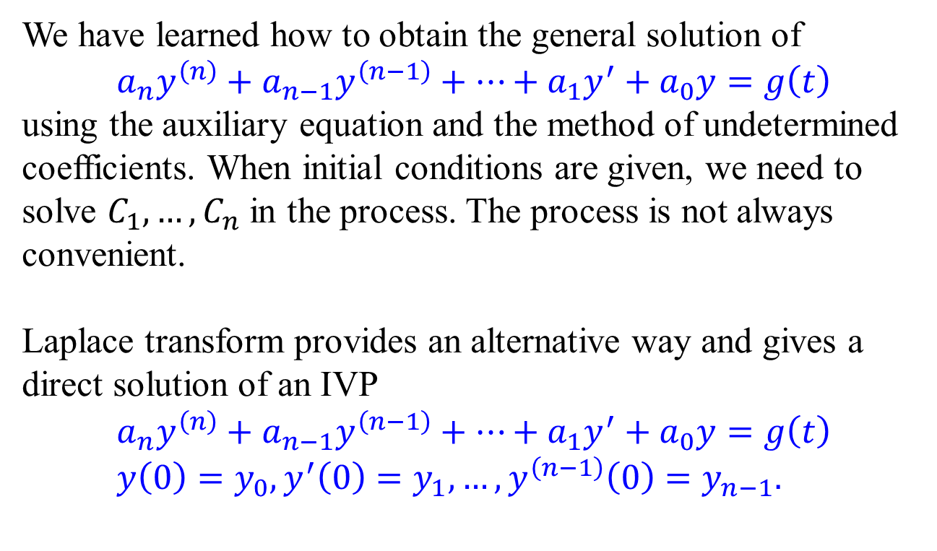
Laplace transform of a linear ODE.
We have learned how to obtain the general solution of
$$a_{n}y^{\left(n\right)}+a_{n−1}y^{\left(n−1\right)}+⋯+a_{1}y^{′}+a_{0}y=g\left(t\right)$$ using the auxiliary equation and the method of undetermined coefficients. When initial conditions are given, we need to solve $C_{1},…, C_{n}$ in the process. The process is not always convenient.
Laplace transform provides an alternative way and gives a direct solution of an IVP
$$a_{n}y^{\left(n\right)}+a_{n−1}y^{\left(n−1\right)}+⋯+a_{1}y^{′}+a_{0}y=g\left(t\right) \\ y\left(0\right)=y_{0},y^{′}\left(0\right)=y_{1},…,y^{\left(n−1\right)}\left(0\right)=y_{n−1}.$$

Slide 15
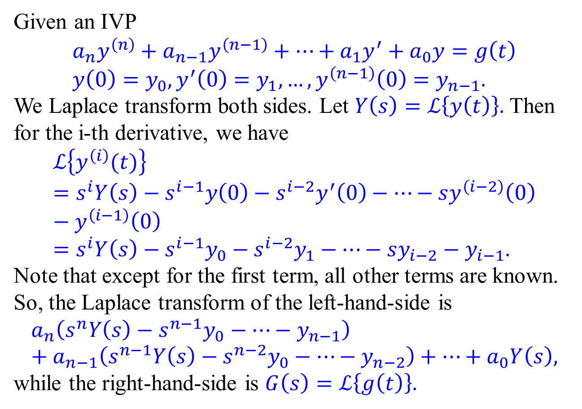
Laplace transform of a linear ODE.
Given an IVP
$$a_{n}y^{\left(n\right)}+a_{n−1}y^{\left(n−1\right)}+⋯+a_{1}y^{′}+a_{0}y=g\left(t\right) \\ y\left(0\right)=y_{0},y^{′}\left(0\right)=y_{1},…,y^{\left(n−1\right)}\left(0\right)=y_{n−1}.$$
We Laplace transform both sides. Let $Y\left(s\right)=ℒ\left\{y\left(t\right)\right\}.$ Then for the i-th derivative, we have
$$ℒ\left\{y^{\left(i\right)}(t)\right\}=s^{i}Y\left(s\right)−s^{i−1}y\left(0\right)−s^{i−2}y^{′}\left(0\right)−⋯−sy^{\left(i−2\right)}\left(0\right)−y^{\left(i−1\right)}\left(0\right) \\ =s^{i}Y\left(s\right)−s^{i−1}y_{0}−s^{i−2}y_{1}−⋯−sy_{i−2}−y_{i−1}.$$
Note that except for the first term, all other terms are known.
So, the Laplace transform of the left-hand-side is
$$a_{n}\left(s^{n}Y\left(s\right)−s^{n−1}y_{0}−⋯−y_{n−1}\right)+a_{n−1}\left(s^{n−1}Y\left(s\right)−s^{n−2}y_{0}−⋯−y_{n−2}\right)+⋯+a_{0}Y\left(s\right),$$
while the right-hand-side is $G\left(s\right)=ℒ\left\{g\left(t\right)\right\}.$

Slide 16
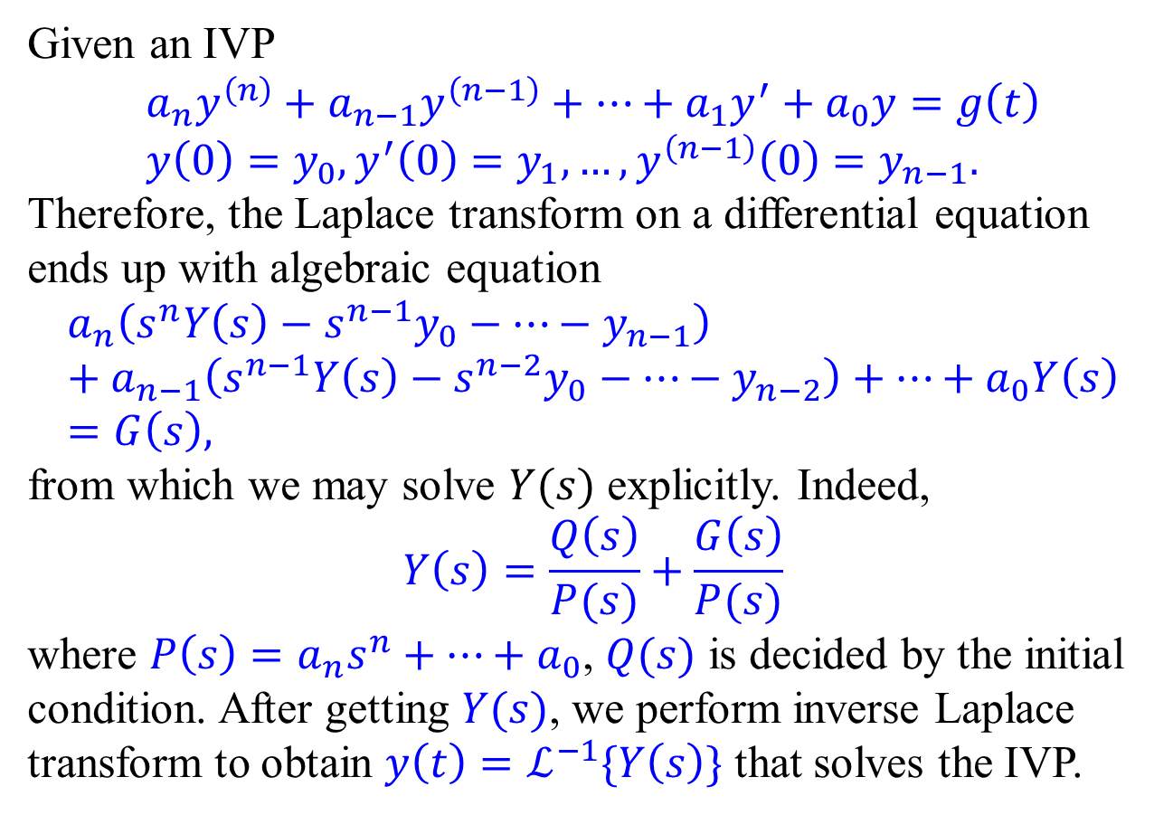
Laplace transform of a linear ODE.
Given an IVP
$$a_{n}y^{\left(n\right)}+a_{n−1}y^{\left(n−1\right)}+⋯+a_{1}y^{′}+a_{0}y=g\left(t\right) \\ y\left(0\right)=y_{0},y^{′}\left(0\right)=y_{1},…,y^{\left(n−1\right)}\left(0\right)=y_{n−1}.$$
Therefore, the Laplace transform on a differential equation ends up with algebraic equation
$$a_{n}\left(s^{n}Y\left(s\right)−s^{n−1}y_{0}−⋯−y_{n−1}\right)+a_{n−1}\left(s^{n−1}Y\left(s\right)−s^{n−2}y_{0}−⋯−y_{n−2}\right)+⋯+a_{0}Y\left(s\right)=G\left(s\right),$$
from which we may solve $Y(s)$ explicitly. Indeed,
$$Y\left(s\right)=\frac{Q\left(s\right)}{P(s)}+\frac{G\left(s\right)}{P(s)}$$
where $P\left(s\right)=a_{n}s^{n}+⋯+a_{0}$, $Q(s)$ is decided by the initial condition. After getting $Y(s)$, we perform inverse Laplace transform to obtain $y\left(t\right)=ℒ^{−1}\{Y\left(s\right)\}$ that solves the IVP.

Slide 17
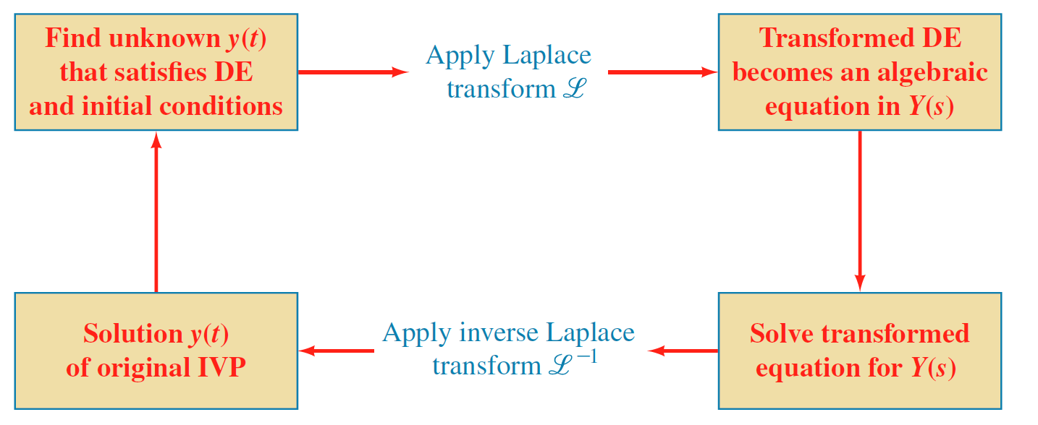
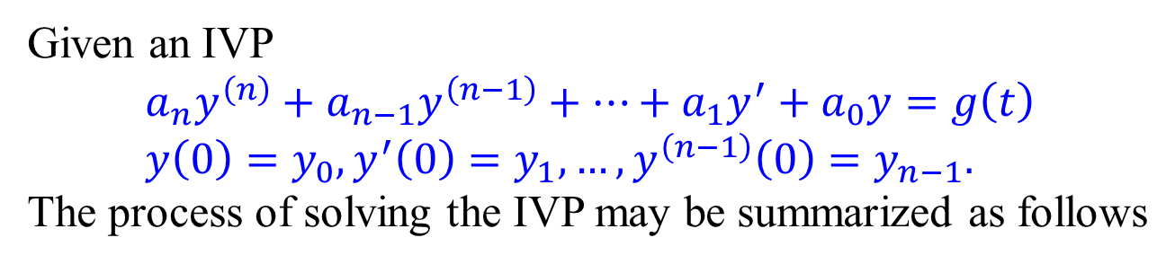
Laplace transform of a linear ODE.
Given an IVP
$$a_{n}y^{\left(n\right)}+a_{n−1}y^{\left(n−1\right)}+⋯+a_{1}y^{′}+a_{0}y=g\left(t\right) \\ y\left(0\right)=y_{0},y^{′}\left(0\right)=y_{1},…,y^{\left(n−1\right)}\left(0\right)=y_{n−1}.$$
The process of solving the IVP may be summarized as follows

Slide 18
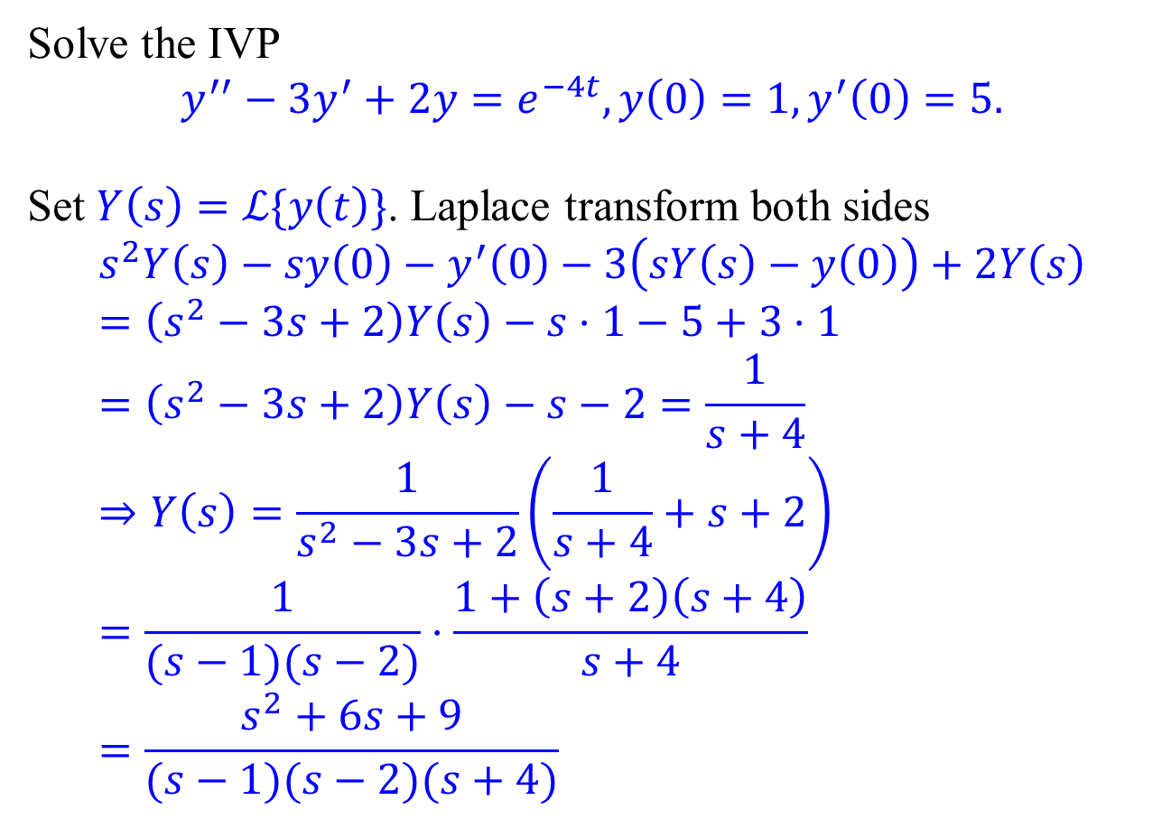
Example 1
Solve the IVP $$y^{′′}−3y^{′}+2y=e^{−4t},y\left(0\right)=1,y^{′}\left(0\right)=5.$$
Set $Y\left(s\right)=ℒ\{y\left(t\right)\}$. Laplace transform both sides
$$s^{2}Y\left(s\right)−sy\left(0\right)−y^{′}\left(0\right)−3\left(sY\left(s\right)−y\left(0\right)\right)+2Y\left(s\right) \\ =\left(s^{2}−3s+2\right)Y\left(s\right)−s⋅1−5+3⋅1 \\ =\left(s^{2}−3s+2\right)Y\left(s\right)−s−2=\frac{1}{s+4} \\ ⇒Y\left(s\right)=\frac{1}{s^{2}−3s+2}\left(\frac{1}{s+4}+s+2\right) \\ =\frac{1}{(s−1)(s−2)}⋅\frac{1+\left(s+2\right)\left(s+4\right)}{s+4} \\ =\frac{s^{2}+6s+9}{(s−1)(s−2)(s+4)}$$

Slide 19
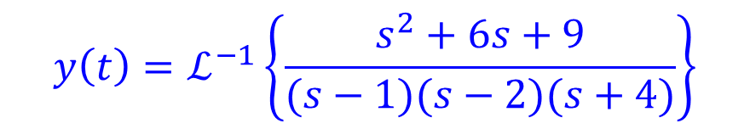
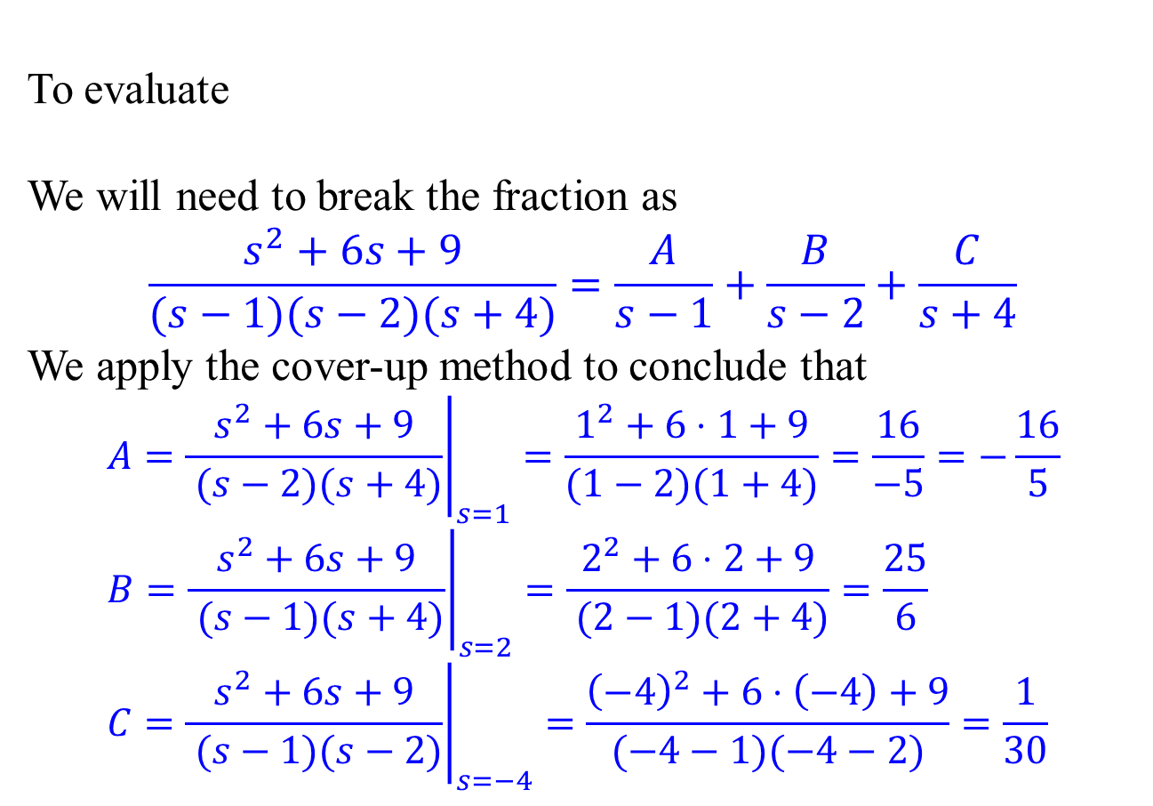
Partial Fractions – Linear factors
To evaluate
We will need to break the fraction as
$$\frac{s^{2}+6s+9}{(s−1)(s−2)(s+4)}=\frac{A}{s−1}+\frac{B}{s−2}+\frac{C}{s+4}$$
We apply the cover-up method to conclude that
$$A={\left.\frac{s^{2}+6s+9}{ (s−2)(s+4)}\right|}_{s=1}=\frac{1^{2}+6⋅1+9}{(1−2)(1+4)}=\frac{16}{−5}=−\frac{16}{5} \\ B={\left.\frac{s^{2}+6s+9}{ (s−1)(s+4)}\right|}_{s=2}=\frac{2^{2}+6⋅2+9}{ (2−1)(2+4)}=\frac{25}{6} \\ C={\left.\frac{s^{2}+6s+9}{ (s−1)(s−2)}\right|}_{s=−4}=\frac{{\left(−4\right)}^{2}+6⋅\left(−4\right)+9}{(−4−1)(−4−2)}=\frac{1}{30}$$
$$y\left(t\right)=ℒ^{−1}\left\{\frac{s^{2}+6s+9}{(s−1)(s−2)(s+4)}\right\}$$

Slide 20
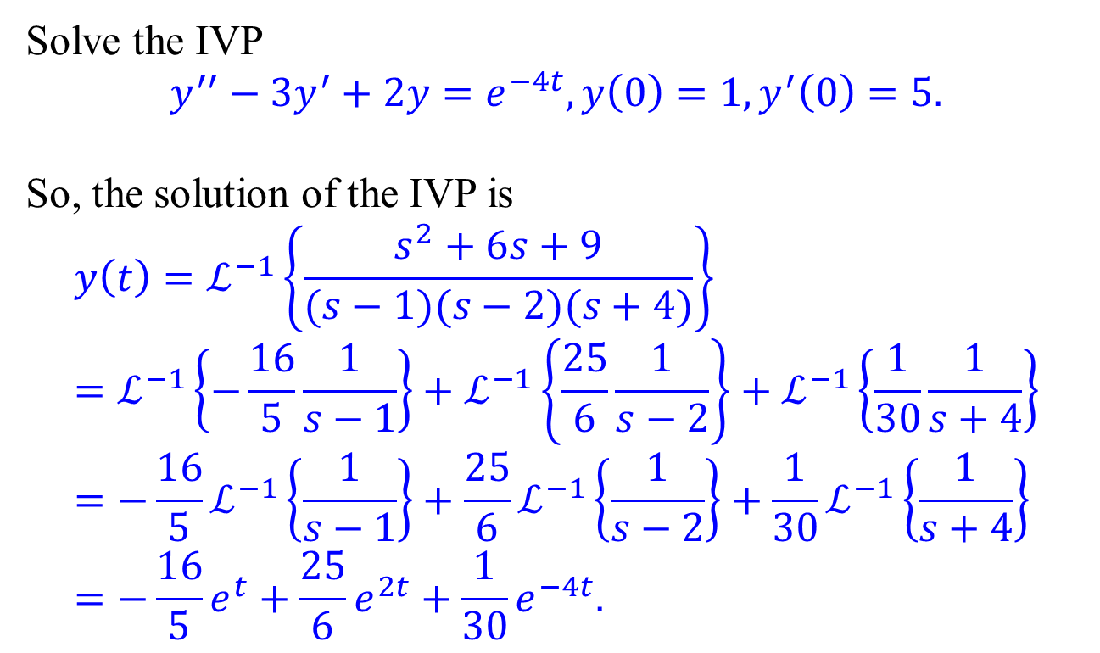
Partial Fractions – Linear factors
Solve the IVP $$y^{′′}−3y^{′}+2y=e^{−4t},y\left(0\right)=1,y^{′}\left(0\right)=5.$$
So, the solution of the IVP is
$$y\left(t\right)=ℒ^{−1}\left\{\frac{s^{2}+6s+9}{(s−1)(s−2)(s+4)}\right\} \\ =ℒ^{−1}\left\{−\frac{16}{5}\frac{1}{s−1}\right\}+ℒ^{−1}\left\{\frac{25}{6}\frac{1}{s−2}\right\}+ℒ^{−1}\left\{\frac{1}{30}\frac{1}{s+4}\right\} \\ ={−\frac{16}{5}ℒ}^{−1}\left\{\frac{1}{s−1}\right\}+\frac{25}{6}ℒ^{−1}\left\{\frac{1}{s−2}\right\}+\frac{1}{30}ℒ^{−1}\left\{\frac{1}{s+4}\right\} \\ =−\frac{16}{5}e^{t}+\frac{25}{6}e^{2t}+\frac{1}{30}e^{−4t}.$$

Slide 21
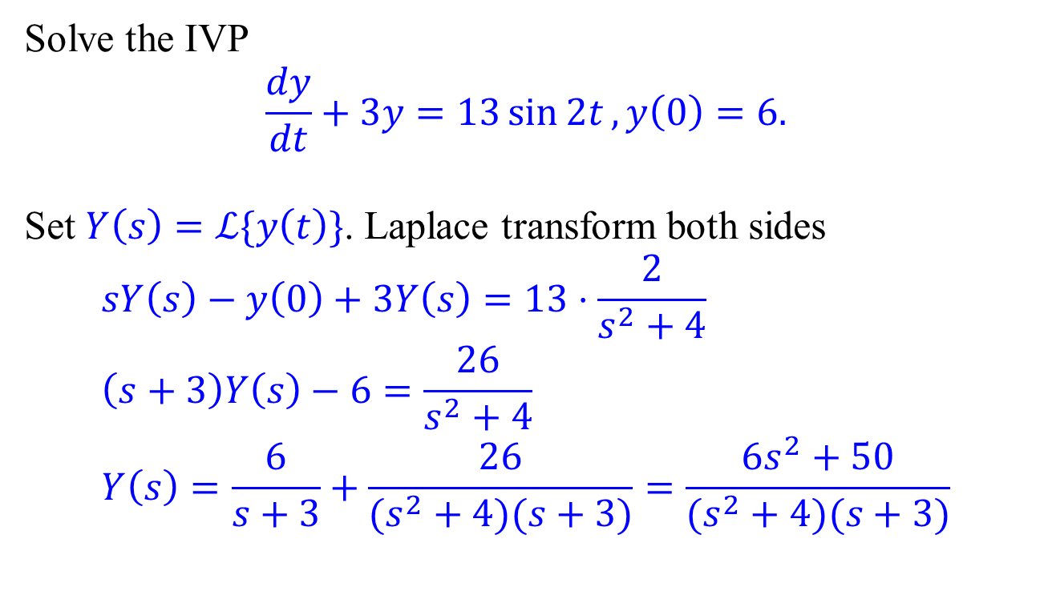
Example 2
Solve the IVP $$\frac{dy}{dt}+3y=13\sin{2t}, y\left(0\right)=6.$$
Set $Y\left(s\right)=ℒ\{y\left(t\right)\}$. Laplace transform both sides
$$sY\left(s\right)−y\left(0\right)+3Y\left(s\right)=13⋅\frac{2}{s^{2}+4} \\ \left(s+3\right)Y\left(s\right)−6=\frac{26}{s^{2}+4} \\ Y\left(s\right)=\frac{6}{s+3}+\frac{26}{(s^{2}+4)(s+3)}=\frac{6s^{2}+50}{(s^{2}+4)(s+3)}$$

Slide 22
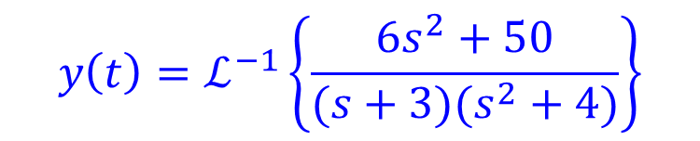
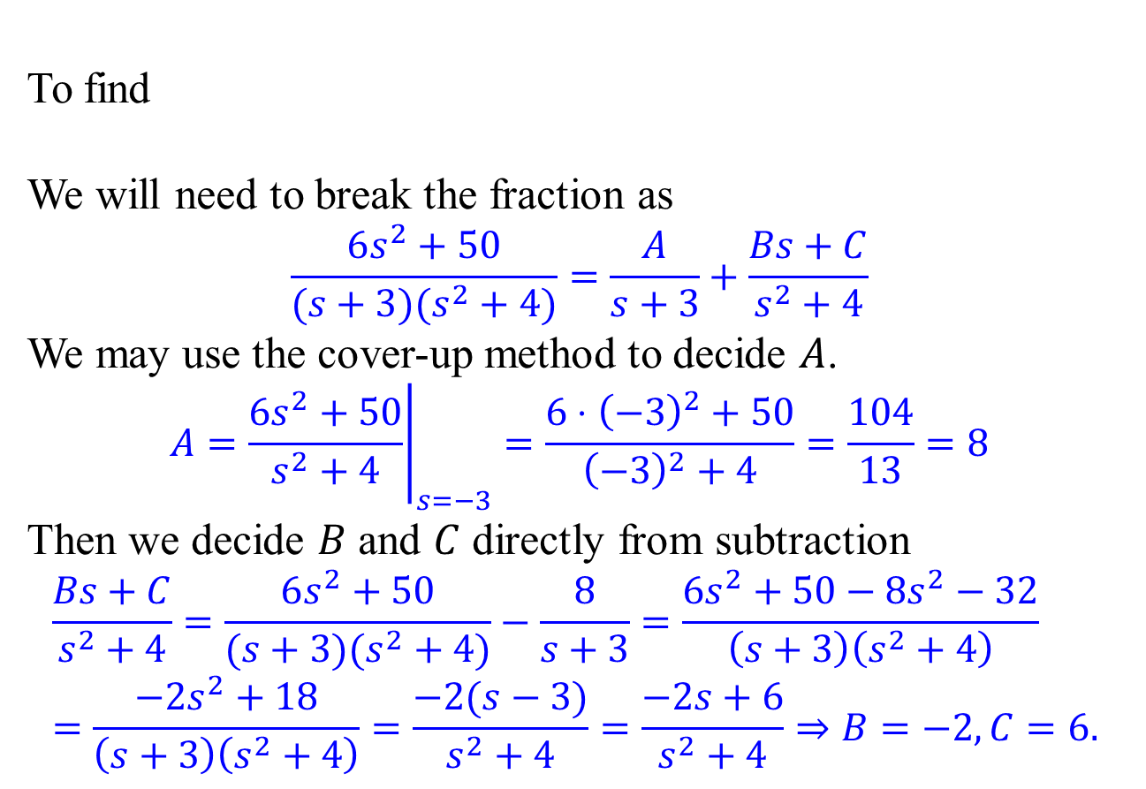
Partial Fractions – Linear and quadratic factors
To find
We will need to break the fraction as
$$\frac{6s^{2}+50}{(s+3)(s^{2}+4)}=\frac{A}{s+3}+\frac{Bs+C}{s^{2}+4}$$ We may use the cover-up method to decide $A$.
$$A={\left.\frac{6s^{2}+50}{s^{2}+4}\right|}_{s=−3}=\frac{6⋅{\left(−3\right)}^{2}+50}{{\left(−3\right)}^{2}+4}=\frac{104}{13}=8$$
Then we decide $B$ and $C$ directly from subtraction
$$\frac{Bs+C}{s^{2}+4}=\frac{6s^{2}+50}{(s+3)(s^{2}+4)}−\frac{8}{s+3}=\frac{6s^{2}+50−8s^{2}−32}{\left(s+3\right)\left(s^{2}+4\right)} \\ =\frac{−2s^{2}+18}{\left(s+3\right)\left(s^{2}+4\right)}=\frac{−2(s−3)}{s^{2}+4}=\frac{−2s+6}{s^{2}+4}⇒B=−2, C=6.$$
$$y\left(t\right)=ℒ^{−1}\left\{\frac{6s^{2}+50}{(s+3)(s^{2}+4)}\right\}$$

Slide 23
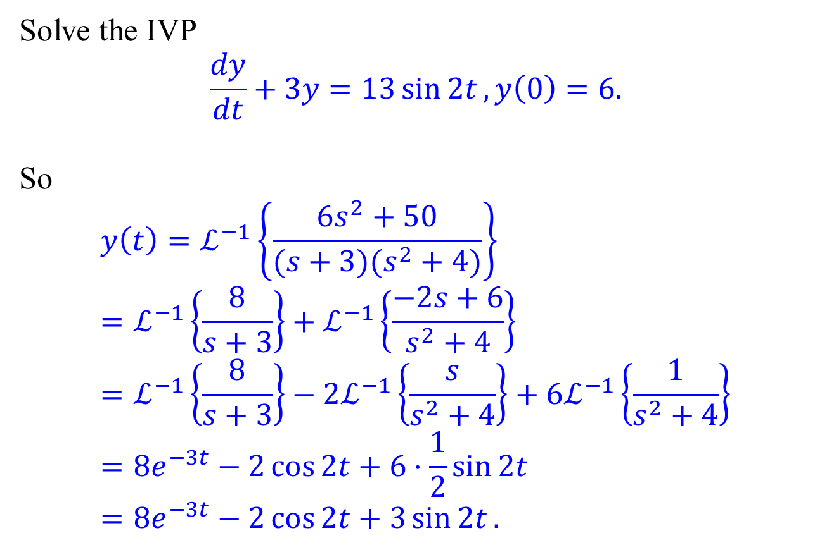
Partial Fractions – Linear and quadratic factors
Solve the IVP $$\frac{dy}{dt}+3y=13\sin{2t}, y\left(0\right)=6.$$
So
$$y\left(t\right)=ℒ^{−1}\left\{\frac{6s^{2}+50}{(s+3)(s^{2}+4)}\right\} \\ =ℒ^{−1}\left\{\frac{8}{s+3}\right\}+ℒ^{−1}\left\{\frac{−2s+6}{s^{2}+4}\right\} \\ =ℒ^{−1}\left\{\frac{8}{s+3}\right\}−2ℒ^{−1}\left\{\frac{s}{s^{2}+4}\right\}+6ℒ^{−1}\left\{\frac{1}{s^{2}+4}\right\} \\ =8e^{−3t}−2\cos{2t}+6⋅\frac{1}{2}\sin{2t} \\ =8e^{−3t}−2\cos{2t}+3\sin{2t}.$$

